Slide 1
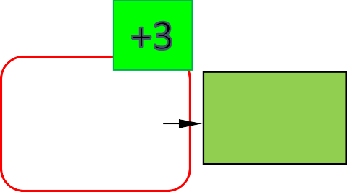
Field 1 Computer & Control
Field 2 Electrical & Electronics
BFM 18/19
BFF3801
Thermal-Fluid Engineering Lab
BFM4902
Final Year Project 1
BFM4914
Final Year Project 2
BFF2223
Fluid Mechanics
BFF2233
Thermodynami cs
BFf3242
Heat Transfer
BFM3403
Fluid Drive System
BFM4**3A
Mechatronics Elective 1
BFM4**3B
Mechatronics Elective 2
BFM4603
Control System 2
BFM3323
Power Electronics
BFF1103
Statics
BFF1123
Dynamics
BFM4503
Robotics for Engineers
BFM4**3C
Mechatronics Elective 3
BFM4613
Digital Signal Processing
BFM3313
Electrical Power Machine
BFF1113
Engineering Materials
BFF2821
Mechanics Lab
BFF3103
Vibrations
BFF1801
Machining 1
BFF1133
Mechanics of Materials
BFF2403
Manufacturing Processes 1
BFM3002
Computer Simulation
BFF4103
Control System Engineering
BFF3123
Machine Design
BFM4313
Industrial Electronics
BFF1811
Machining 2
BFM4323
Digital System in Mechatronics Design
BFF1602
Technical Drawing
BFF2612
Computer Aided Engineering Design
BFF3622
Computer Aided Manufacturing
BFF1922
Engineering Economy
BFF1502
Project Management
BFM2303
Analog Electronics
BFF3313
Sensor and Instrumentation Systems
BFM3333
Microcontroller System
BFF3573
Product Design & Development
BFF4563
Integrated Design Project
Field 3 Mechanics & Automation
Field 4 Software
BUM2123
Applied Calculus
BFF4906
Industrial Training
BFF1343
Fundamental Electrical Engineering
BFM2831
Fundamental of Electrical Engineering Lab
BFM3713
Electrical Drive System
BUM2133
Ordinary Differential Equations
BFM2313
Digital Electronics
BFM4513
Automation System
BFM3003
Artificial Inteligence
BFF2003
Computer Programming
BFM2013
Programming For Engineers
UGE2002
Technopreneurship
UHM2022
Ethnic Relations
UQB1**1
Co-Curriculum I
UHR1012
Islamic and Asian Civilizations 1
UQ*2**1 Co-Curriculum
II
BFM4523
Autonomous Robotic System
BFM4013
Computer Network in Mechatronics System
BUM2413
Applied Statistics
UHE3**2
Elective Courses
UHL2400
Fundamentals of English Language
UHS1021
Soft Skills 1
UHS2021
Soft Skill 2
BFF1922
Engineers in Society
BFF4911
Environment Safety and Health
BFM4533
Robotic Prototype Design
BFM4633
Data Analytics
UHL2412
UHL2422
English For Technical Communicatio
n
UHL2432
English For Professional Communications
English For Academic Communicatio n
UHF11*1
Foreign Language Level 1
UHF21*1
Foreign Languages Level 2
Curriculum structure BFM effective Sem 1 2018/2019.
138

